Slide 1


CSE 593
Dr. Yinong Chen

Slide 2
Proposal and Final Report
Proposal
Final Report
Abstract/Summary
Introduction
Related work
Design alternatives
Deliverables
Planning and management
Conclusion and Summary
Abstract/Summary
Introduction
Related work
Design, alternatives
Modeling, simulation, analysis
Implementation
Testing, quantitative evaluation, results interpretation, and ethical implications
Conclusion and Summary
Dr. Yinong Chen

Slide 3
Title Page & Table of Contents
Title, author, affiliation
Table of contents must be automatically generated from headings in the report, at least two levels of headings
MS Word:
  Using Styles to define headings
  Using “Insert Table of Contents” to generate the table of contents of the selected levels
Dr. Yinong Chen

Slide 4
Abstract/Summary
Abstract is to 300 words (this is a maximum!)
Summary could be one page long
Key Information to convey:
  Why is this project needed
  What is this project is about
    Include a brief synopsis of your solution
  What is the intellectual merit
    What are the novel elements of your solution.
  What are the main results of the project
  What are the impact of the results
Needs to pass the elevator speech test
  Someone majoring in a non-technical major should be able read & understand the summary
Exercise
  Find the above elements in the abstract in the report sample from the class blackboard website.
Dr. Yinong Chen

Slide 5
Introduction
Key Information:
  Reason for project
    More detailed than abstract
  Project description and objectives
    Problem definition
    Project description
    Objectives: should be tangible, measurable or demonstrable
  Background of the project
  What is done in the project
    Include a summary of your solution
  Innovation, impact, and uniqueness of your design
  Organization of the rest of the report
Dr. Yinong Chen

Slide 6
Introduction
Notes
  You don’t have to follow the order in the outline precisely.
    For instance, you can discuss background and problem statement together
  Your abstract contains sentences, your introduction contains paragraphs
Organization of rest of paper
  Always the last part of the introduction
  Include section numbers and names
  Guideline: One sentence per section
    Example:
      Section 3 presents our framework, outlines the analytical model that drives adaptation in TAF, and describes three TAF-based protocols for optimizing different, relevant metrics.
Dr. Yinong Chen

Slide 7
Related Work
Literature review and existing designs (This part must extended in the final related)
  Classify related work
  Draw some conclusions about related work
    Where is it strong
    Where could it have been improved
Comparison of the work done in this project with the existing work.
  What related work are we using
  What related work are we extending
  What related work are we improving upon
Dr. Yinong Chen

Slide 8
Design Alternatives
Key elements:
  Overview of the system and architecture
  Components of the system
  Interface, interconnection, and interaction among the components
    Include diagrams
    Explain the diagrams in text
    If you mention something, make sure it is explained
  Environment in which the system is implemented
  Hardware and software supporting the system
  Alternative solutions considered in the design, using KTDA to evaluate the alternatives
  Implementation considerations
    Include key design tradeoffs in selecting among the alternatives
  Certain implementation details of your system
Needs to pass the “TA” test
  A tech-savvy Teaching Assistant should be able to read this and understand your solution
Dr. Yinong Chen

Slide 9
Modeling and Quantitative Evaluation
Key Elements
  Evaluation objectives (performance, dependability, and/or cost)
  Conceptual model of the overall system and its components
  Mathematical model
  Test plan of components and evaluating the parameters
  Evaluation of components and parameters of the model
  Test plan and evaluation of the overall system
  Experiment design
    Be specific
      Wrong
        We stood on our chassis to see if it was strong enough
      Right
        We subjected our chassis to a vertical forces of up 250 lbs in 25 lb. intervals. We measured the chassis deformation at each interval.
  Experiment results
    Graphs, charts, tables
      Wrong
        We found we needed a 7 MP camera to get good results
      Right
        A graph showing % words recognized as a function of camera resolution
  Interpretation of the experiment results
  Ethical implications
Notes
Dr. Yinong Chen

Slide 10
Conclusion and Summary
Key Elements
  Create 1-sentence summaries of major components (sections) of the report.
    By Sections, we mean the Design, Implementation, Modeling and Qualitative Evaluation sections.
  Discuss design and features contributing to the project’s success (or failure).
  Major contributions and impact of the work conducted in this report.
  Give recommendations: discuss the lessons and design improvements that could be considered in future development. Be specific.
Notes
  Read the conclusion paragraph in the sample report for a example of a conclusion
Dr. Yinong Chen

Slide 11
Acknowledgements
Key Elements
  Describe each team member's contribution in the project and in writing this report;
  Acknowledge any external help received in the process of the project implementation and in writing this report.
Should pass the “feelings” test
  No contributor should feel “slighted” because legitimate contributions were ignored
Dr. Yinong Chen

Slide 12
References
References
  Authors
  Article Title
  Publication Information
  Year Published
Use IEEE format:
  http://www.ieee.org/portal/cms_docs/pubs/transactions/auinfo03.pdf
  http://www.ece.uiuc.edu/pubs/ref_guides/ieee.html
What about web references?
  If not author listed, use the name of the company or organization that sponsors the web site
    [4] IBM Developers Works. IBM SOA Foundation: An architectural introduction and overview, Dec 8, 2005, http://www.ibm.com/developerworks/webservices/library/ws-soa-whitepaper.
Cross-reference in Word
  You can bind a reference citation to an item in the reference list;
  Citation-reference item link will not be affected by insertion, deletion, or reordering of reference items.
Dr. Yinong Chen

Slide 13
About the authors
Should be self explanatory
Two pages at most
Dr. Yinong Chen

Slide 14
General Writing Tips
Language
  Grammar is important
  Spelling is important
    Why does a robot need a “diving service”
    Why does you system have a “sitcom link”?
      Your, you’re and yore are different words
      So Its and it’s are
  Watch your sentence structure
    Please don’t make your report painful to read!
Dr. Yinong Chen

Slide 15
General Writing Tips
Language
  Avoid placing unnecessary and superfluous words (and phrases) in your sentences in order to reduce the number of words in your sentences thereby making it easier for your reader understand the point your are trying to make without making your reader wade through blither and blather and all other manners of prose that really do not provide any more information, in fact they obscure your point so maybe your reader will not really understand what it was your were trying to communicate in the first place.
Dr. Yinong Chen

Slide 16
General Writing Tips
Itemization
  When you have a list of things, use bullets lists or italicized text
  The process steps to are analyze, categorize, and itemize.
Don’t use contractions, they’re not acceptable. I’m really serious. I’ll repeat this, you shouldn’t use contractions they aren’t acceptable! If you don’t use contractions, I won’t deduct any point off because you’ve used them.
Dr. Yinong Chen

Slide 17
General Writing Tips
Know the difference between
  its, it’s,
  their, there, they’re,
  your, you’re, yore
  accept, except,
  affect, effect
  loose, lose, loss,
  to, two, too,
  than, then,
  who, which, that
Dr. Yinong Chen

Slide 18
General Writing Tips – Figures and Tables
ALL figures and tables should
  a) be numbered sequentially in the document;
  b) have a descriptive caption;
  c) be placed below the figure and diagram. For tables, caption (title) can be placed
  above the table;
  d) be centered on the page;
The figure and table must be cited in the document. The citation should appear before the figure and table. If they are not in the immediate next to the citation, the reader should be told where to find it, for example, at the end of the document or in the appendix.
If a figure or table is too detailed or too big to place in the body of the document, it should be placed at the end of the report in a section titled, Appendix.
Dr. Yinong Chen

Slide 19
General Writing Tips
Proofread
  Before you submit your report, sit down as a team, if team work is involved, and take turns reading it out loud (change every paragraph).
Dr. Yinong Chen

Slide 20
Literature Review -- Writing About “Prior Art”
Discuss each related work in a short (at least a sentence, no more than a paragraph or two) summary.
Cite [1] the related work with the correct number in the references section.
Categorize or classify the related work.
Draw conclusions about the strengths and weaknesses of the related work.
Note:
  Strengths are areas of prior work you project is using or extending
  Weaknesses are problem areas that your project is addressing
Dr. Yinong Chen

Slide 21
How to use References
Related work
  Example – You are doing a autonomous security robot, you look at recent publications about autonomous robots and security robots.
Data that supports design or solution decisions
  Example – You want a battery that will power your robot for X hours, you need to cite specifications for power requirements for your control system and your locomotion system, and specifications for the battery system you are proposing to use
Dr. Yinong Chen

Slide 22
How to present analysis
Charts, Graphs, and Tables
Describe the results
Example (table):
Four analysis runs were made. The first run used the same parameters as the EAGER analysis. For run #2, the radio transmission and reception energy costs were increased by an order of magnitude. For run #3, the size of the network was reduce to 25% of its original size. The number of nodes was also reduced so that the node density matched runs 1 and 2. Finally, for run #4 the number of nodes in the network was doubled. See Table 6 for a complete list of network parameters.
Table 6: Network parameters for the analysis runs.
Run # | N | R | E_{tx}, E_{rcv} | E_{d}
1 | 30000 | 1000 | 50E-10 | 10E-12
2 | 30000 | 1000 | 50E-9 | 10E-10
3 | 7500 | 500 | 50E-10 | 10E-12
4 | 60000 | 1000 | 50E-10 | 10E-12
Dr. Yinong Chen

Slide 23
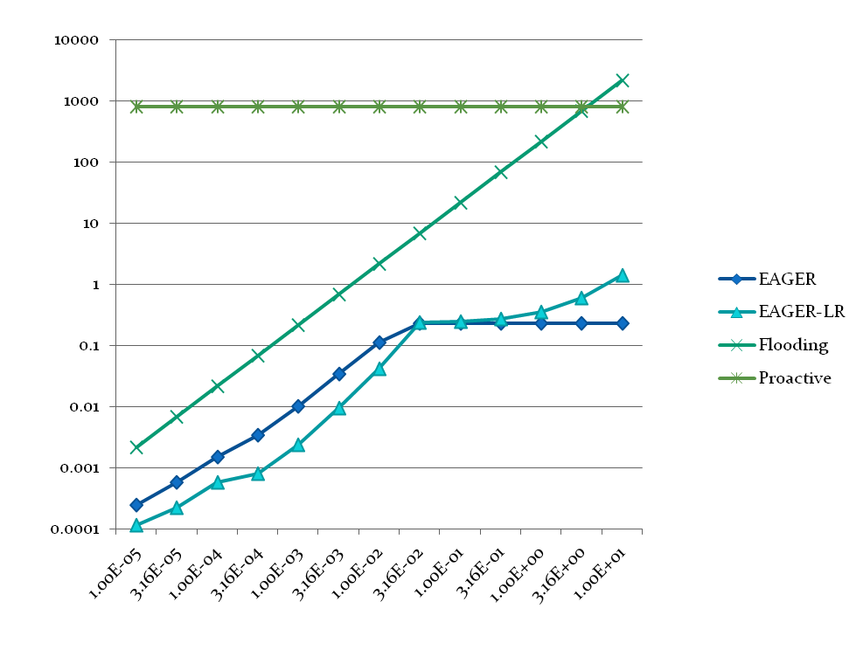
Presenting Results
Example (graph)
Figure 7: Run 1, N=60000, R=1000
Dr. Yinong Chen

